Slide 1
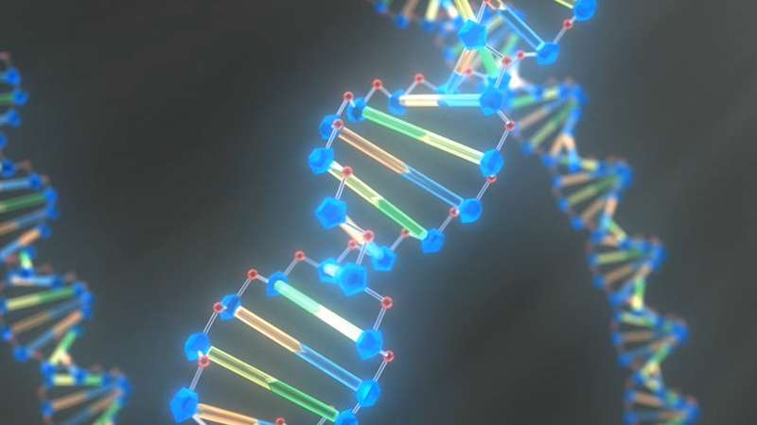

Phylogeny: construction, visualization and interpretation
Gildas Hounmanou, PhD
APTI-Fellow, National Institutes of Health, MD, USA
Assistant-Professor
https://orcid.org/0000-0003-3991-0864
University of Copenhagen
Faculty of Health and Medical Sciences
Section for Food Safety and Zoonoses
Department of Veterinary and Animal Sciences

Slide 2
Outline
Phylogeny inference from SNPs
Phylogenetic tree construction
Phylogenetic tree interpretation
Phylogenetic tree visualization – Microreact

Slide 3
Phylogeny
Phylogeny represents the evolutionary relationships and relatedness between a group of organisms.
Inferred from single nucleotide polymorphisms (SNPs)
SNPs are allelic nucleotide variants at given positions in the genome.
For phylogeny analyses, SNPs are assumed to be:
Independent
Random

Slide 4
Inferring phylogeny from SNPs – Overview
Select reference and map reads to reference
The closer the reference to the sample data, the better.
Reference region with no matching reads
Reads not matching reference
Mapping/ alignment
Raw reads (Post QC)
Reference sequence
Software: BWA mem, samtools, Mauve…

Slide 5
Inferring phylogeny from SNPs – Overview
2. Call SNPs / variant calling and filtering of low quality SNPs
T
T T
T
T C C C
A A
A
C G C G C G A G C G A G
C C C
T
T
T
A
C
C C
C G A G C
T
T
C G A T C
C G A G C
A A GT A
G
Reference sequence
Software: Samtools, VarScan, bcftools…

Slide 6
Inferring phylogeny from SNPs – Overview
3. Filter recombination (optional)
Remove SNPs due to recent recombination events e.g mobile elements
Often identified by relative SNP densities (clustering) along the alignment
T
T T
T
T C C C
A A
A
C G C G C G A G C G A G C G A G
C C C C C
T
T
T
A
C
C C
T
T
C G A T C G A G A A GT
C
G
A
Reference sequence Software: Gubbins…

Slide 7
Inferring phylogeny from SNPs – Overview
Concatenate filtered SNPs to create pseudogenomes and a pseudoalignment.
Constructed from only shared positions in all genomes and reference
T
T T
T T C
C C
A A
A
C C
C C C
C A
Isolate 1: TTAC
Isolate 2: TTAC
Isolate 3: TTAC
Isolate 4: TTAC
Isolate 5: TCCC
Isolate 6: TCCC
Pseudoalignment
T
T
Alignment
T
A
C
C C
T
T
G
Reference sequence

Slide 8
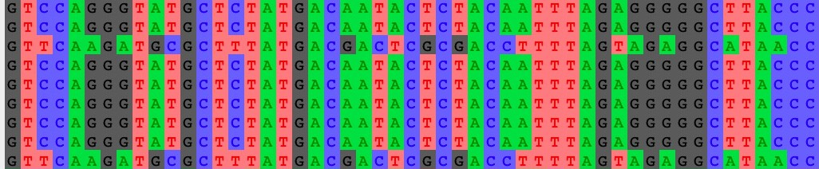
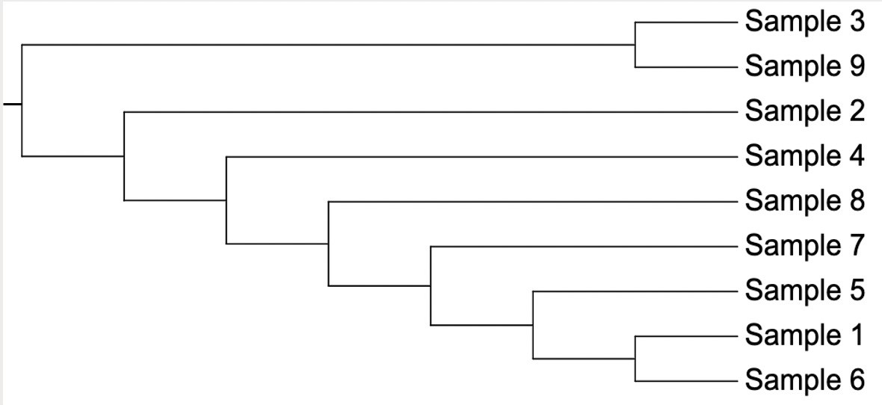
Inferring phylogeny from SNPs – Overview
5. Construct phylogenetic tree from pseudoalignment using chosen method and algorithm.
Sample 1
Sample 2
Sample 3
Sample 4
Sample 5
Sample 6
Sample 7
Sample 8
Sample 9
Pseudoalignment
Tree construction
Software: IQ-Tree, FastTree, RaxML

Slide 9
Phylogenetic tree interpretation
Node and hypothetical ancestor of isolates 1 and 2
Taxon
Taxa are on the tree tips/leaves
Nodes: hypothetical taxa ancestors
Branches connect nodes and taxa
Topology: branching structure of a tree
Clade: taxa sharing a unique common ancestor
Bootstraps: proportion of multiple replicate trees supporting each node.
Root: more distantly related to all taxa on the tree; tells direction of evolution
Branch
Isolate 1
Most recent
hypothetical
0.9
ancestor of
studied isolates
Isolate 2
1.0
Isolate 3
Isolate 4
0.7
0.9
Isolate 5
80%
bootstrap
0.8
Isolate 6
support
Root
Scale
0.1

Slide 10
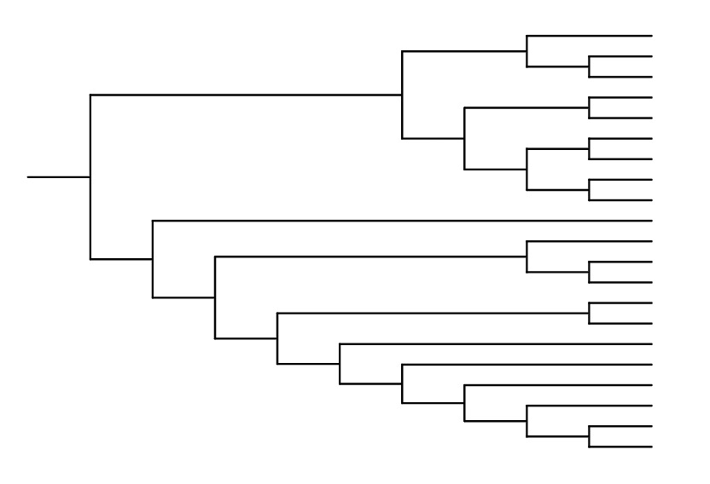
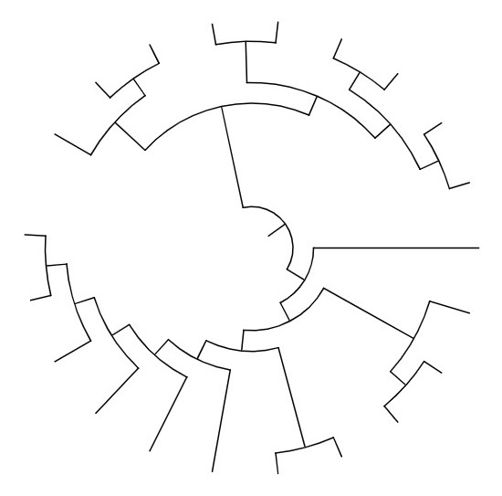
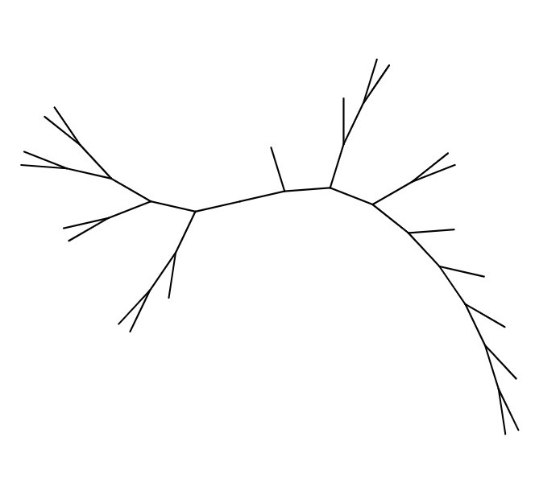
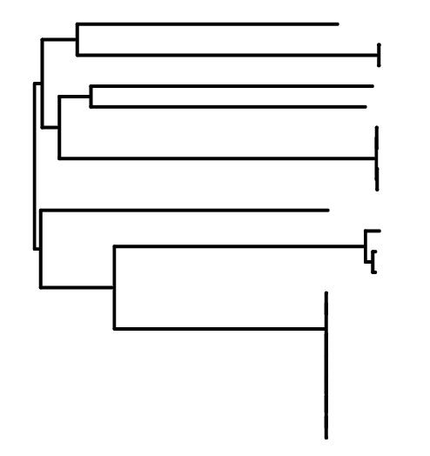
Phylogenetic tree interpretation
Reading phylogenetic trees
Trees depict branching history; topology most important.
Different orientations, same topology.
Unless otherwise indicated, branch lengths are meaningless; avoid inferring temporal information that is not shown
Branch lengths, when indicated, reflect the amount of evolutionary change as well as the passage of time.
x
y
x
y
0.01

Slide 11






















Phylogenetic tree interpretation: Misconceptions
1. Evolutionary timeline flows from tips/leaves
Present
Past
Past
Present
Evolution is not linear but nested
2. Related species have proximal leaves
==
Relationships are inferred from common ancestry, not leaf proximity

Slide 12

















Phylogenetic tree interpretation: Misconceptions
3. Genetic change occurs only at nodes
Fact:
Changes accumulate in taxa over time and are present along branches
Nodes simply represent (hypothetical) common ancestors between taxa
Shared ancestor; divergence event
Unique ancestor
D
C
B
A
4. Related species have fewer connecting nodes
3 connecting nodes = less related
2 connecting nodes = more related

Slide 13
Phylogenetic tree visualisation: Microreact
A flexible, interactive software/web application for easy visualization of datasets consisting of a combination of trees, maps, timelines, and associated metadata.
Input:
Data file: Comma separated values (.csv) format; can contain a combination of textual metadata, locations and dates.
Optional tree file: Newick (.nwk) format.
Output: interactive tree, map, timeline, and table.

Slide 14
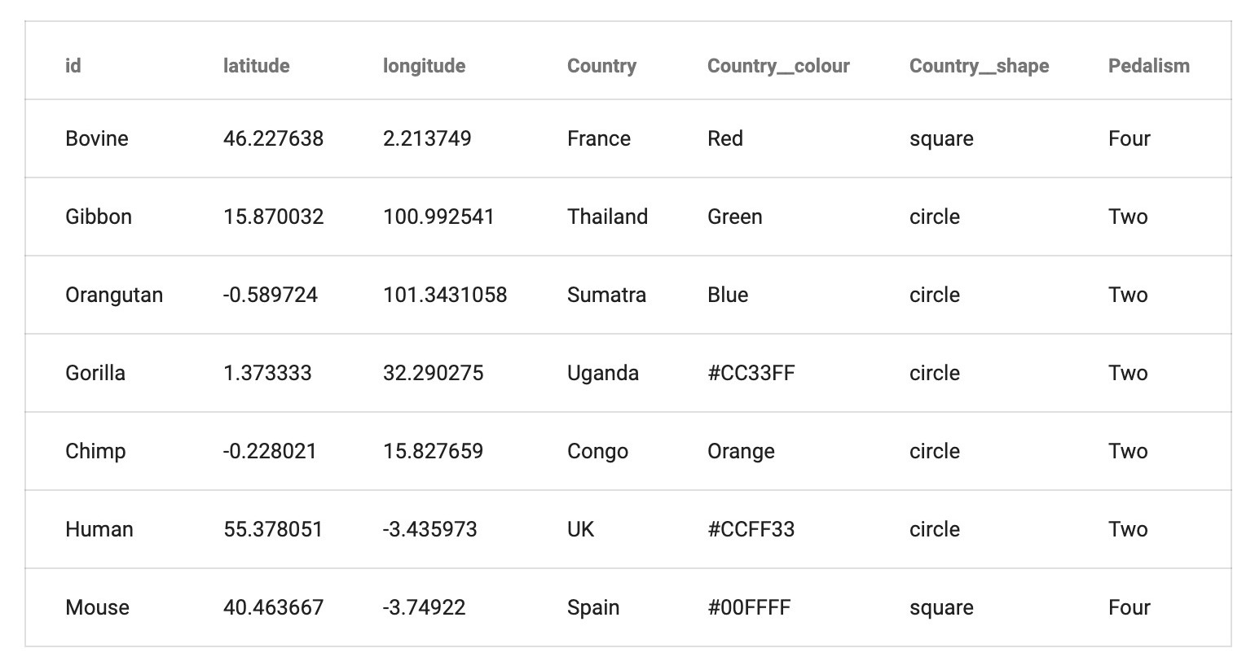
Phylogenetic tree visualisation: Microreact
Sample data file
Mandatory column
id
– unique identifier for each data row
Optional columns
latitude, – geographic columns
longitude
year, month,
day
temporal columns
other metadata
<custom-name>
<column-name> colour
specify colour
specify shape
https://microreact.org/instructions
<custom-name> shape

Slide 15
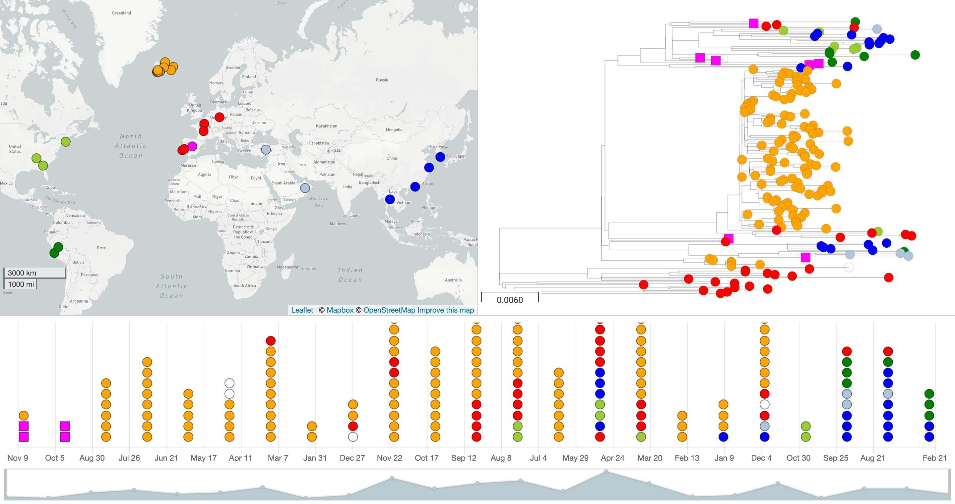




Phylogenetic tree visualisation: Microreact
Data file (.csv)
+/-
Web application https://microreact.org
Tree file (.nwk)
Source: https://microreact.org/project/N1TRn11L

Slide 16
Microreact benefits
Powerful visualization and data exploration
Visualization can be shared as a permanent web link among collaborators.
The web link can be embedded within publications to enable readers to explore and download the data.
Simple and easy-to-use, yet powerful

Slide 17

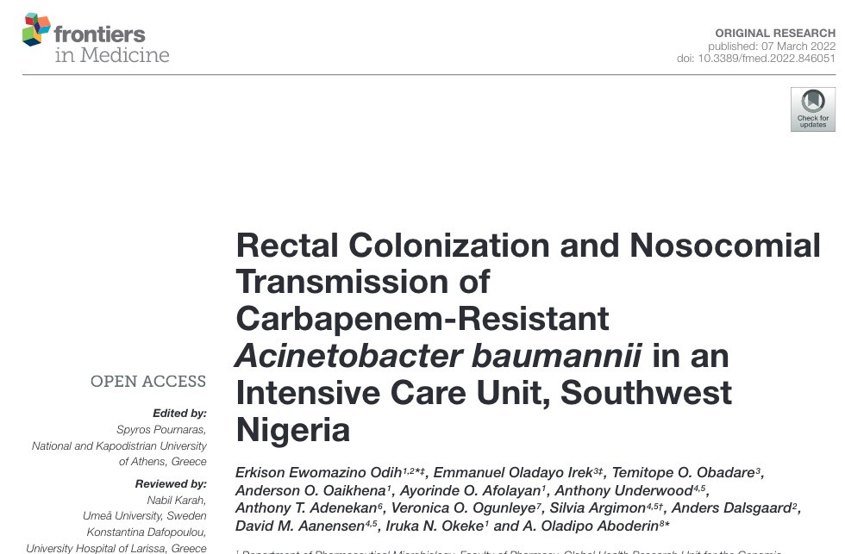
Microreact demo

Slide 18


Gildas Hounmanou, PhD
APTI-Fellow, National Institutes of Health, MD, USA
Assistant-Professor
https://orcid.org/0000-0003-3991-0864
University of Copenhagen
Faculty of Health and Medical Sciences
Section for Food Safety and Zoonoses
Department of Veterinary and Animal Sciences

